Slide 1
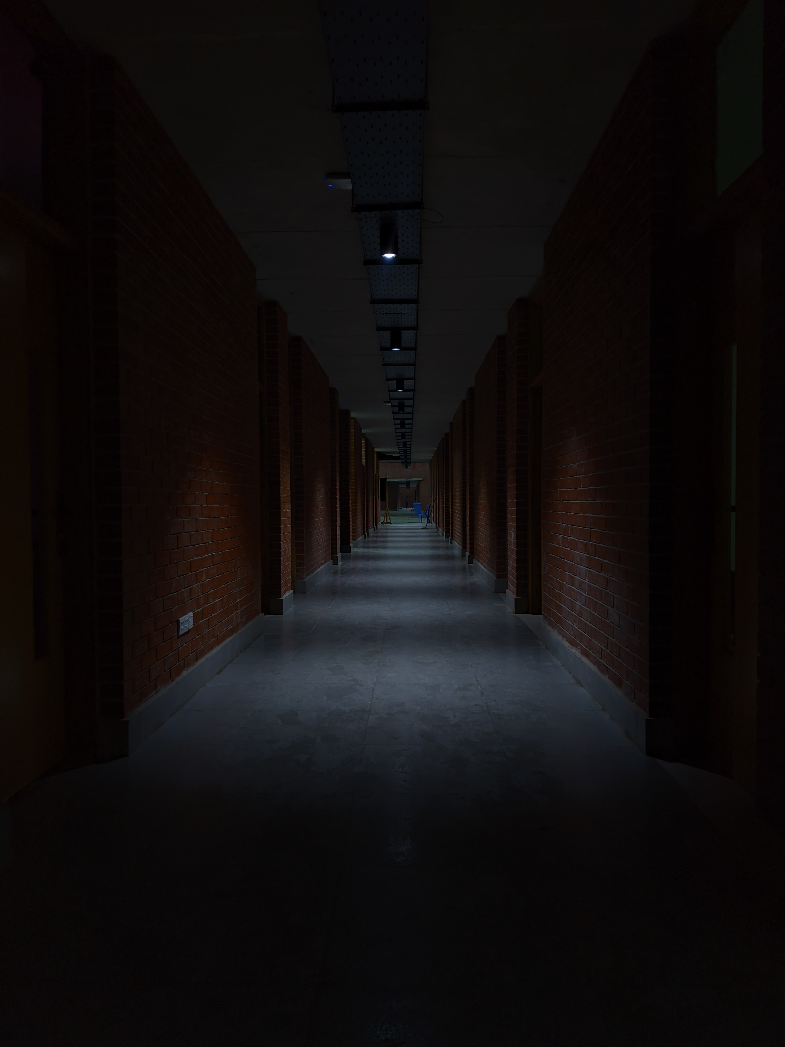


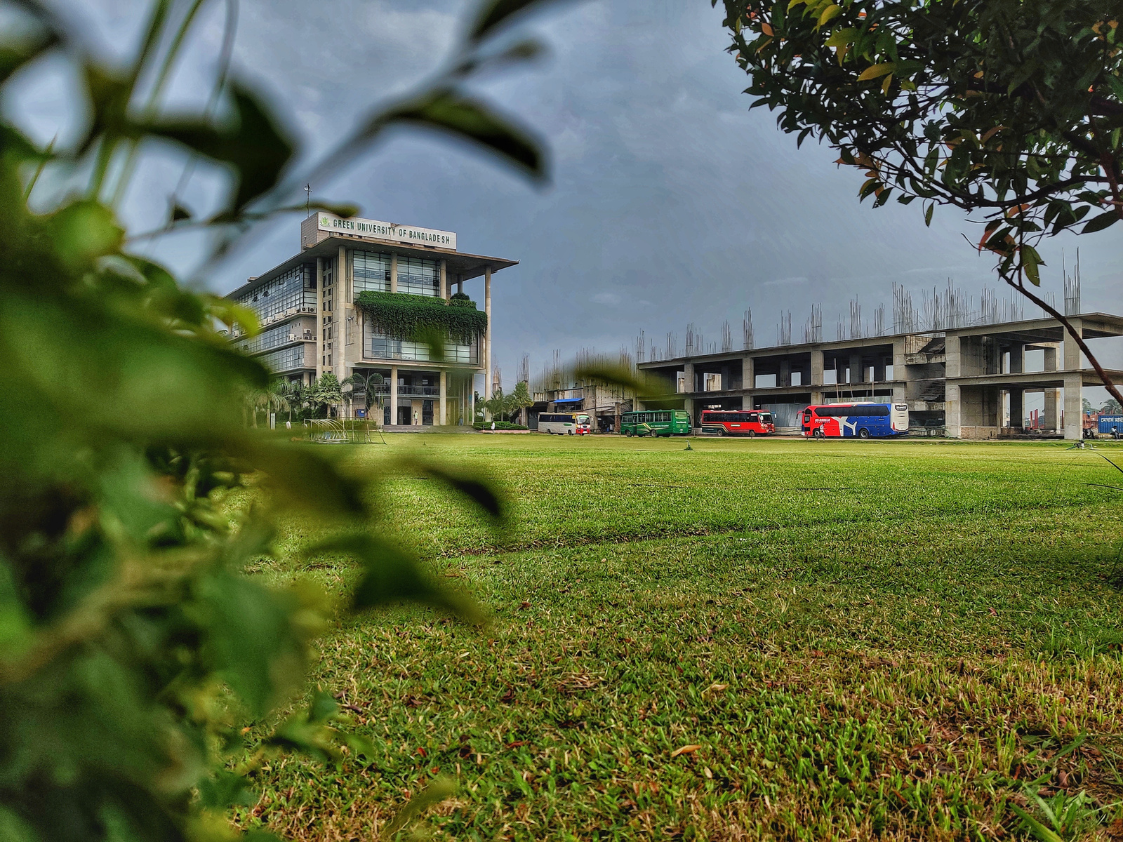
Green University of Bangladesh
Department Of Computer Science and Engineering(CSE)
Course Title: Electronic Devices and Circuits & Pulse Techniques Lab
Course Code: EEE 204 Section: 221 D8
Presented to
Abdullah Al Mahmood
Lecturer, Dept. of EEE
Green University Of Bangladesh

Slide 2




Welcome To Our Presentation
Mobile Phone Detector

Slide 3
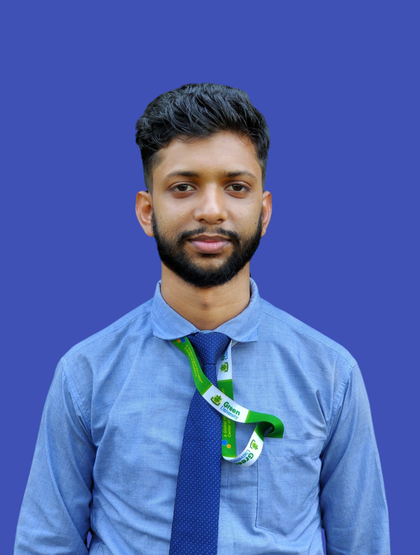
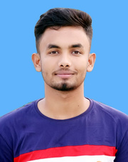

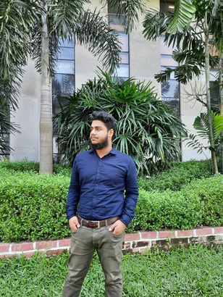


The Team
MD. MAHIM HOSSAIN
MD. Zahidul Islam
MD. Shamim Reja
SK. Nafiue Haque
Ashraful Islam Miraj
Nujhat Tabasum Tisha
221902082
221902091
221902378
221902009
221902231
221902215

Slide 4



TABLE OF CONTENTS
01
Introduction
06
Implementation
02
Motivation
07
Result Analysis
03
Objectives
08
Equipment in Use
04
Methodology
09
Limitation & Future Scope
05
Circuit Diagram
10
Conclusion

Slide 5



Introduction
Introducing the Mobile Phone Detector project, utilizing Computer Architecture principles and the CA3130 operational amplifier IC. This compact device detects mobile phone transmissions within a 1.5-meter range, proving invaluable in restricted areas.

Slide 6


Motivation
Security Enhancement
Compact Efficiency
Technological Response

Slide 7

Objectives
01
02
03
To Foster Practical Skills
To Deepen Component Understanding
To Drive Innovation and Advancements

Slide 8


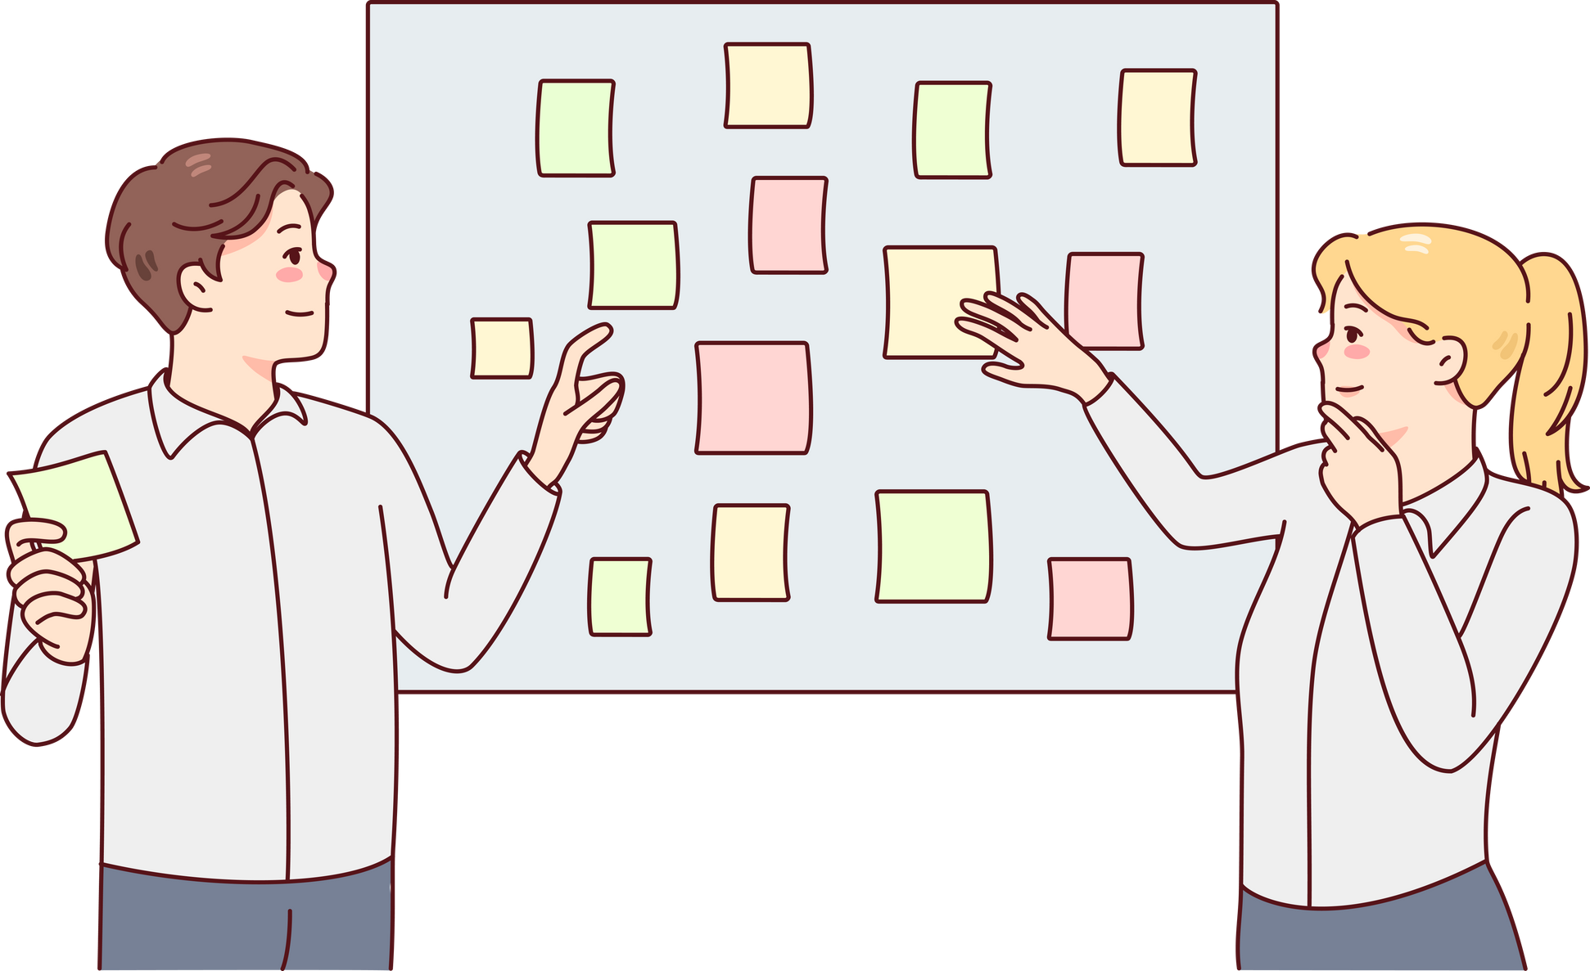
Methodology
LC TUNER CIRCUIT
CURRENT TO VOLTAGE CONVERTER
ANTENNA
OUTPUT STAGE
555
MONOSHOT
CIRCUIT

Slide 9


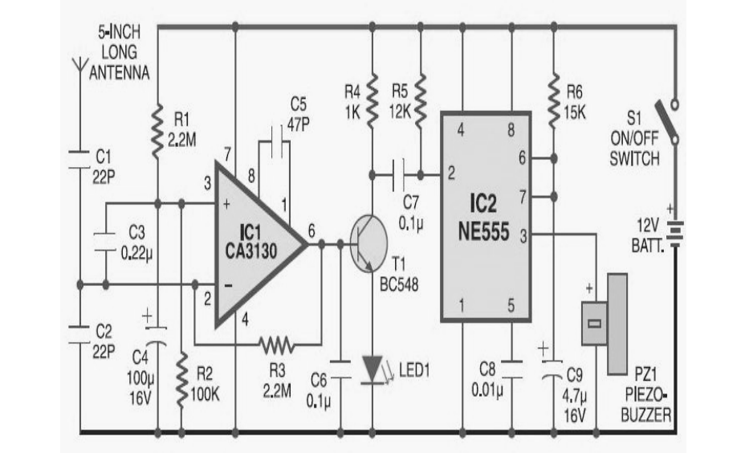

CIRCUIT DIAGRAM

Slide 10


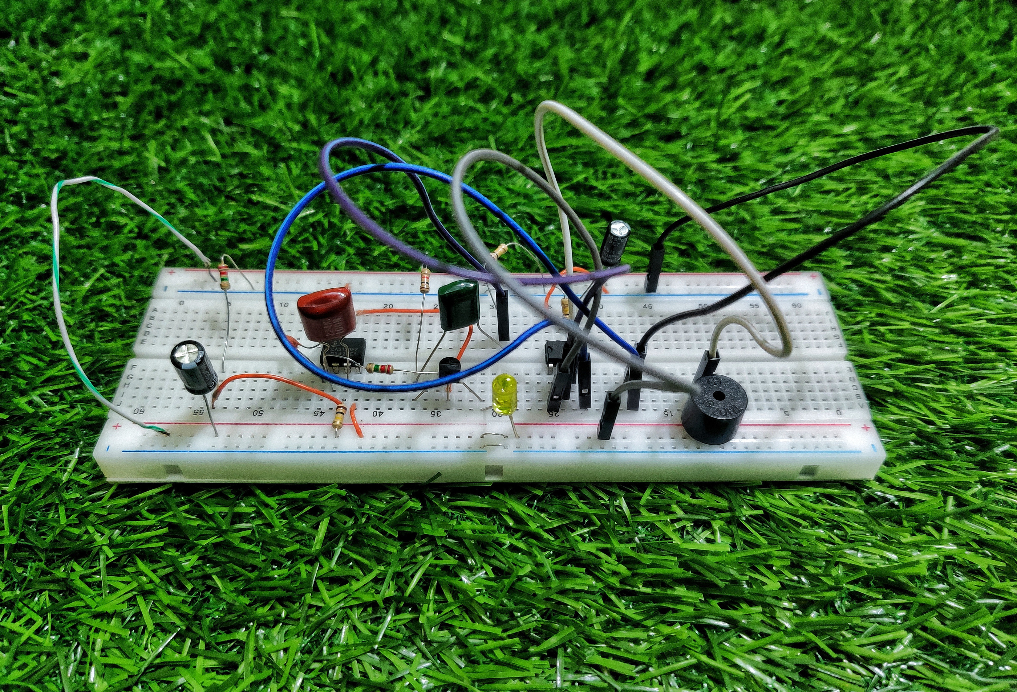
IMPLEMENTATION
Implementation of Mobile Phone Cetector

Slide 11

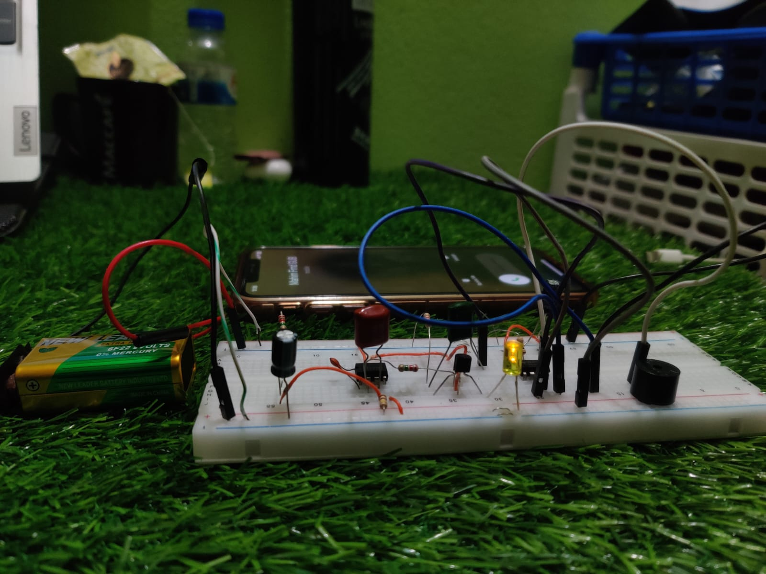

RESULT ANALYSIS

Slide 12


EQUIPMENT IN USE
CA3130 IC
NE555 IC
Resistors (2.2MΩ, 100KΩ, 10KΩ,1KΩ )
Capacitors (10µF 50V, 100µF 63V, 104pF, 0.22µF / 224pF, 47pF)
Buzzer BC548
Transistor
LED(light-emitting diode)
Breadboard
some connecting wire

Slide 13

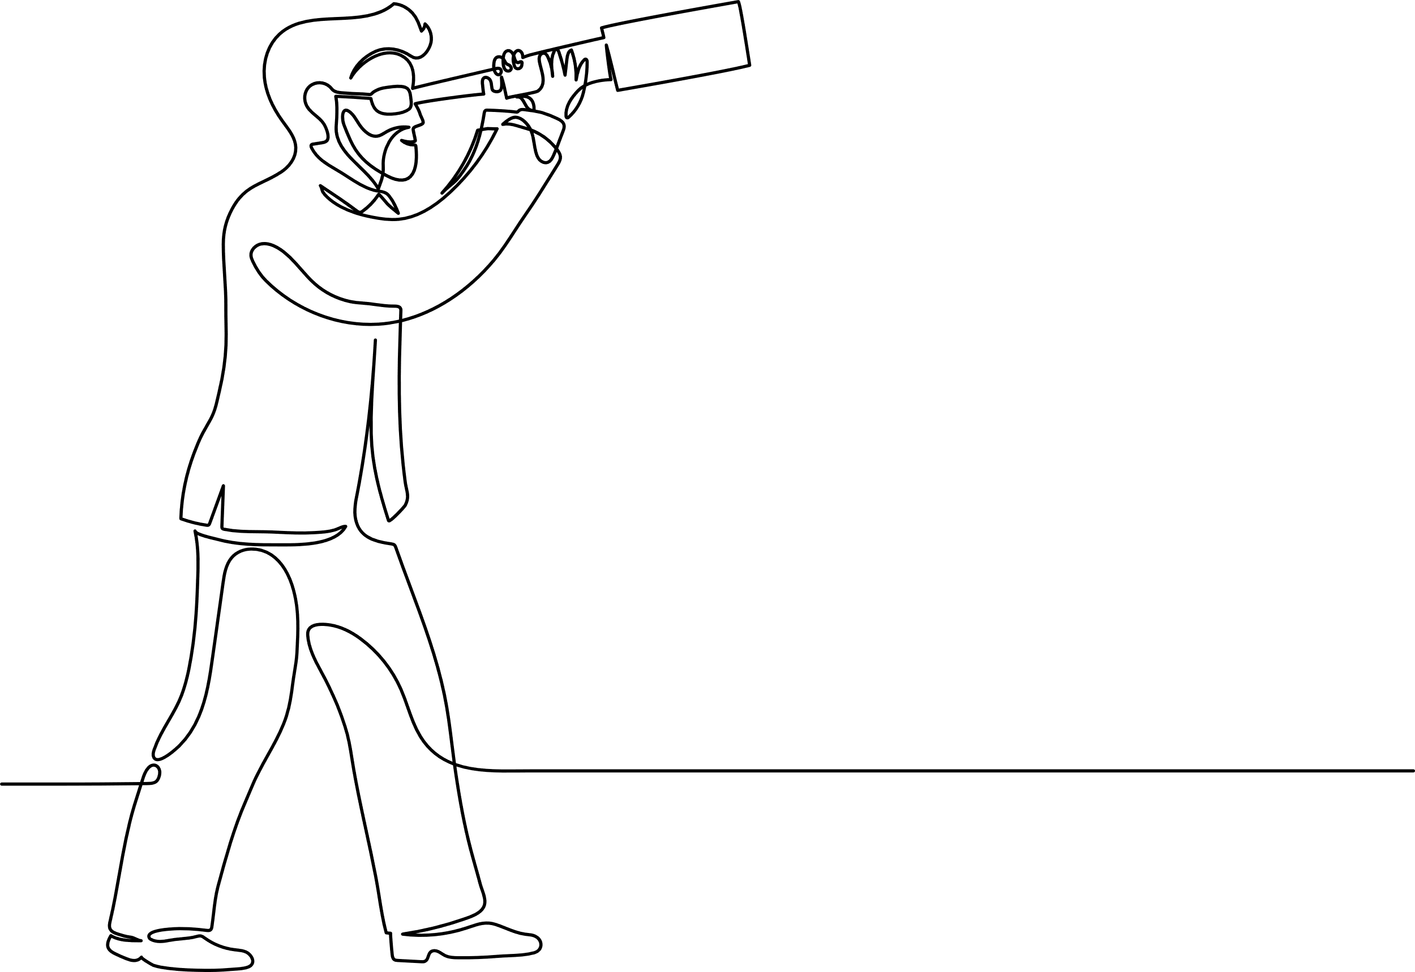
LIMITATION & FUTURE SCOPE
LIMITATION
Limited Range
Amplification Gap
Dependency on Transistor Type
Increased Complexity
FUTURE SCOPE
Extended Detection Range
Frequency Range Expansion
Comprehensive Improvements
Adaptability to Emerging Technologies

Slide 14


CONCLUSION
The Mobile Phone Detector project provides hands-on learning, theoretical understanding, and innovation, fostering practical skills and advancing computational systems.
Holistic Learning Experience
Reliability-Advancement Balance
Educational Impact

Slide 15



Thanks for Watching
Any Question, Just Ask don't be shy

